Slide 1
Expressjs framework
Dr. Adeel Ansari

Slide 2
Topics to be covered
ExpressJS Framework
Routing
Web Server with Express

Slide 3
What is Expressjs?
In this tutorial, we will study the Express framework. This framework is built in such a way that it acts as a minimal and flexible Node.js web application framework, providing a robust set of features for building single and multipage, and hybrid web application.
Express.js is a Node js web application server framework, which is specifically designed for building single-page, multi-page, and hybrid web applications.
It has become the standard server framework for node.js. Express is the backend part of something known as the MEAN stack.

Slide 4
What is Expressjs?
The MEAN is a free and open-source JavaScript software stack for building dynamic web sites and web applications which has the following components;
1) MongoDB - The standard NoSQL database
2) Express.js - The default web applications framework
3) Angular.js - The JavaScript MVC framework used for web applications
4) Node.js - Framework used for scalable server-side and networking applications.
The Express.js framework makes it very easy to develop an application which can be used to handle multiple types of requests like the GET, PUT, and POST and DELETE requests.

Slide 5
Installing and using Express
Express gets installed via the Node Package Manager. This can be done by executing the following line in the command line
The above command requests the Node package manager to download the required express modules and install them accordingly.
Let's use our newly installed Express framework and create a simple "Hello World" application.
npm install express

Slide 6
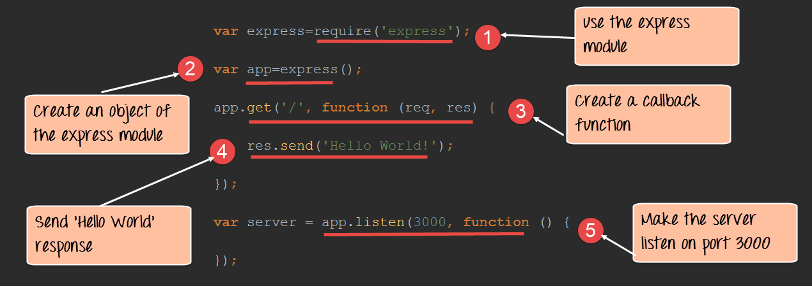
Installing and using Express
Our application is going to create a simple server module which will listen on port number 3000.
In our example, if a request is made through the browser on this port number, then server application will send a 'Hello' World' response to the client.

Slide 7
Installing and using Express
var express=require('express');
var app=express();
app.get('/',function(req,res)
{
res.send('Hello World!');
});
var server=app.listen(3000,function() {});

Slide 8
Code Explanation:
In our first line of code, we are using the require function to include the "express module."
Before we can start using the express module, we need to make an object of it.
Here we are creating a callback function. This function will be called whenever anybody browses to the root of our web application which is http://localhost:3000 . The callback function will be used to send the string 'Hello World' to the web page.
In the callback function, we are sending the string "Hello World" back to the client. The 'res' parameter is used to send content back to the web page. This 'res' parameter is something that is provided by the 'request' module to enable one to send content back to the web page.
We are then using the listen to function to make our server application listen to client requests on port no 3000. You can specify any available port over here.

Slide 9
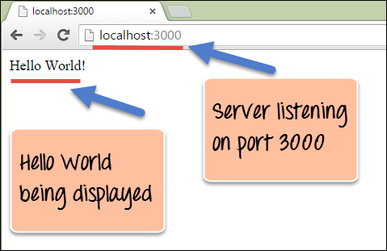
Output
From the output,
You can clearly see that we if browse to the URL of localhost on port 3000, you will see the string 'Hello World' displayed on the page.
Because in our code we have mentioned specifically for the server to listen on port no 3000, we are able to view the output when browsing to this URL.

Slide 10
What are Routes?
Routing determine the way in which an application responds to a client request to a particular endpoint.
For example, a client can make a GET, POST, PUT or DELETE http request for various URL such as the ones shown below;
In the above example,
If a GET request is made for the first URL, then the response should ideally be a list of books.
If the GET request is made for the second URL, then the response should ideally be a list of Students.
So based on the URL which is accessed, a different functionality on the webserver will be invoked, and accordingly, the response will be sent to the client. This is the concept of routing.
http://localhost:3000/Books
http://localhost:3000/Students

Slide 11
Explanation
Each route can have one or more handler functions, which are executed when the route is matched.
The general syntax for a route is shown below
Wherein,
1) app is an instance of the express module
2) METHOD is an HTTP request method (GET, POST, PUT or DELETE)
3) PATH is a path on the server.
4) HANDLER is the function executed when the route is matched.
app.METHOD(PATH, HANDLER)

Slide 12
Example
Let's look at an example of how we can implement routes in the express. Our example will create 3 routes as
A /Node route which will display the string "Tutorial on Node" if this route is accessed
A /Angular route which will display the string "Tutorial on Angular" if this route is accessed
A default route / which will display the string "Welcome to Guru99 Tutorials."
Our basic code will remain the same as previous examples. The below snippet is an add-on to showcase how routing is implemented.

Slide 13
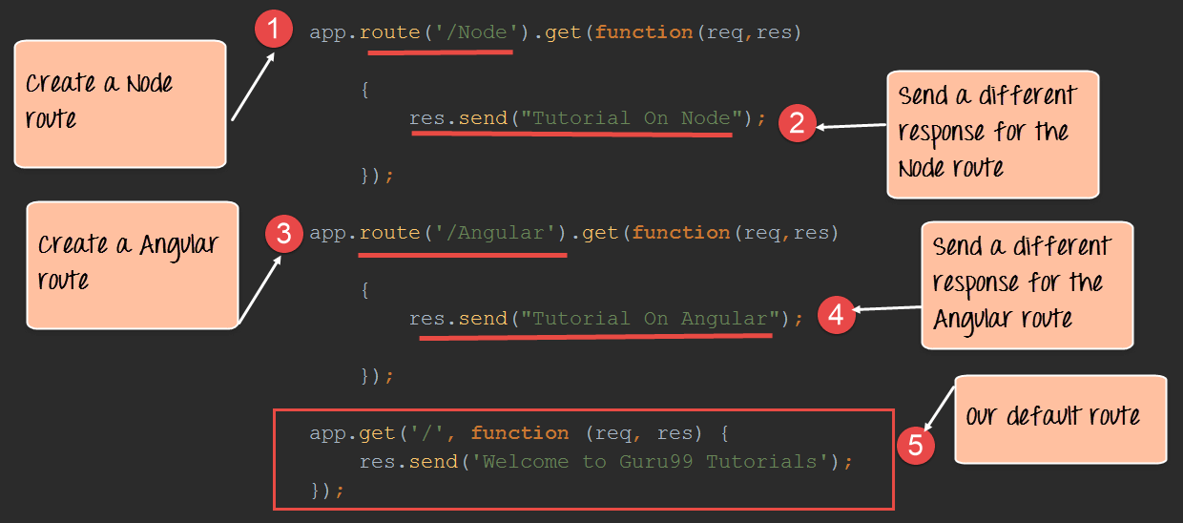

Slide 14
Code
var express = require('express');
var app = express();
app.route('/Node').get(function(req,res)
{
res.send("Tutorial on Node");
});
app.route('/Angular').get(function(req,res)
{
res.send("Tutorial on Angular");
});
app.get('/',function(req,res){
res.send('Welcome to Guru99 Tutorials');
}));

Slide 15
Route methods
A route method is derived from one of the HTTP methods, and is attached to an instance of the express class.
The following code is an example of routes that are defined for the GET and the POST methods to the root of the app.
// GET method route
app.get('/', function (req, res) {
res.send('GET request to the homepage’)
})
// POST method route
app.post('/', function (req, res) {
res.send('POST request to the homepage’)
})

Slide 16
App.all method
Express supports methods that correspond to all HTTP request methods: get, post, and so on. For a full list, see app.METHOD.
There is a special routing method, app.all(), used to load middleware functions at a path for all HTTP request methods. For example, the following handler is executed for requests to the route “/secret” whether using GET, POST, PUT, DELETE, or any other HTTP request method supported in the http module.
app.all('/secret', function (req, res, next) {
console.log('Accessing the secret section ...’)
next() // pass control to the next handler
})

Slide 17
Route parameters
Route parameters are named URL segments that are used to capture the values specified at their position in the URL. The captured values are populated in the req.params object, with the name of the route parameter specified in the path as their respective keys.
Route path: /users/:userId/books/:bookId
Request URL: http://localhost:3000/users/34/books/8989
req.params: { "userId": "34", "bookId": "8989" }
app.get('/users/:userId/books/:bookId', function (req, res) {
res.send(req.params)
})

Slide 18
Route handlers
You can provide multiple callback functions that behave like middleware to handle a request. The only exception is that these callbacks might invoke next('route') to bypass the remaining route callbacks. You can use this mechanism to impose pre-conditions on a route, then pass control to subsequent routes if there’s no reason to proceed with the current route.
Route handlers can be in the form of a function, an array of functions, or combinations of both, as shown in the following examples.

Slide 19
Route handlers
A single callback function can handle a route. For example:
More than one callback function can handle a route (make sure you specify the next object). For example:
app.get('/example/a', function (req, res) {
res.send('Hello from A!’)
})
app.get('/example/b', function (req, res, next) {
console.log('the response will be sent by the next function ...’)
next()
}, function (req, res) {
res.send('Hello from B!’)
})

Slide 20
Route handlers
var express = require('express');
var app = express();
var cb0 = function (req, res, next) {
console.log('CB0')
next()
}
var cb1 = function (req, res, next) {
console.log('CB1')
next()
}
var cb2 = function (req, res) {
res.send('Hello from C!')
}
app.get('/example/c', [cb0, cb1, cb2])
var server=app.listen(3000,()=>{});
An array of callback functions can handle a route. For example:

Slide 21
Route handlers
var express = require('express');
var app = express();
var cb0 = function (req, res, next) {
console.log('CB0')
next()
}
var cb1 = function (req, res, next) {
console.log('CB1')
next()
}
app.get('/example/d', [cb0, cb1], function (req, res, next) {
console.log('the response will be sent by the next function ...')
next()
}, function (req, res) {
res.send('Hello from D!')
})
var server=app.listen(3000,()=>{});
A combination of independent functions and arrays of functions can handle a route. For example:

Slide 22
Response methods
Method | Description
res.download() | Prompt a file to be downloaded.
res.end() | End the response process.
res.json() | Send a JSON response.
res.jsonp() | Send a JSON response with JSONP support.
res.redirect() | Redirect a request.
res.render() | Render a view template.
res.send() | Send a response of various types.
res.sendFile() | Send a file as an octet stream.
res.sendStatus() | Set the response status code and send its string representation as the response body.

Slide 23
app.route()
var express = require('express');
var app = express();
app.route('/book')
.get(function (req, res) {
res.send('Get a random book')
})
.post(function (req, res) {
res.send('Add a book')
})
.put(function (req, res) {
res.send('Update the book')
})
var server=app.listen(3000,()=>{});
You can create chainable route handlers for a route path by using app.route(). Because the path is specified at a single location, creating modular routes is helpful, as is reducing redundancy and typos.
Here is an example of chained route handlers that are defined by using app.route().
Use Postman extension on chrome browser

Slide 24
express.Router
Use the express.Router class to create modular, mountable route handlers. A Router instance is a complete middleware and routing system; for this reason, it is often referred to as a “mini-app”.
The following example creates a router as a module, loads a middleware function in it, defines some routes, and mounts the router module on a path in the main app.

Slide 25
express.Router
var express = require('express')
var router = express.Router()
// middleware that is specific to this router
router.use(function timeLog (req, res, next) {
console.log('Time: ', Date.now())
next()
})
// define the home page route
router.get('/', function (req, res) {
res.send('Birds home page')
})
// define the about route
router.get('/about', function (req, res) {
res.send('About birds')
})
module.exports = router
Create a router file named RouteMod.js in the app directory, with the following content:

Slide 26
express.Router
App.js
The app will now be able to handle requests to /birds and /birds/about, as well as call the timeLog middleware function that is specific to the route.
var birds = require('./RouteMod') //router is in RouteMod.js
var express=require('express');
var app=express();
// ...
app.use('/birds', birds)
var server=app.listen(3000,()=>{console.log("Connected")});

Slide 27
Reference
https://expressjs.com/en/guide/routing.html
https://developer.mozilla.org/en-US/docs/Learn/Server-side/Express_Nodejs

